Slide 1
Code Reviewing
David Betteridge
david@yorkdevelopers.org
@da_betteridge

Slide 2
Agenda
Quick Introduction
Explain the problem
Work in pairs till 8.45pm
Opportunity to show off solutions
Pub about 9pm

Slide 3
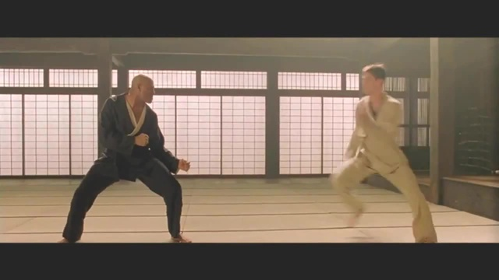
Code Dojo
Notes:
Who has been to a code dojo before?
What is the point?
It’s a place to practice coding safely. By that we mean it doesn’t matter if you haven’t solved the problem by the end of the evening. No one will judge you on it. It’s a place to practice, learn and try out new things.
For example you could use a language you have never used before, partner with someone new, try a different approach to solving the problem. You could add your own constraints; like my functions won’t have more than three lines; or I’m not going to use any IF statements.
(It’s also meant to be fun) It’s driving a car to work every day, you might cover a lot of miles, but if you are doing the same journey then does your driving ability really improve?
It’s driving a car to work every day, you might cover a lot of miles, but if you are doing the same journey then does your driving ability really improve?

Slide 4
Story
“Acompany” has a lot of bugs
You have been hired to help
NDA
Notes:
The global company called “Acompany” has been getting a lot of bug reports from its customers recently. This is beginning to effect their share price.
The board has decided that they require some outside help so they have hired you.
You mission is review a random selection of their code to see if any improvements can be made.
There is code in a few languages, but mainly C# However, Java and C# are very similar.
Before you can start work, you have to agree to their Non-disclosure-agreement. Which basically says that upon leaving this meetup you aren’t allowed to say “That company that X works for has some really rubbish code – I saw some examples at a meetup”

Slide 5
Tonight
while (!TimeForPub)
{
Show(Code);
DiscussIn(Pairs);
DiscussIn(Group);
}
Notes:
Another experimental evening!
I’ll put up some code, which is also on our github site, and on some USB sticks if needed
You then discuss what is good / bad about it in pairs. Write replacement code if you wish
Then we discuss it as a group, and see if we agree / disagree.

Slide 6
Topics
Poorly Formatted
Poor choice of algorithm
Buggy / Edge Cases
Bad Comments
Bad Variable Names / Class Naming
Bad Tests

Slide 7
Next Meeting
14th March 2018 – Andy’s with solving problems with Dynamic Programming
Notes:
Next month is Andy with solving problems with Dynamic Programming

Slide 8
York Developers
Games Developers (Last Thursday of the month)
Code and Coffee (Monday and Wednesday mornings)
Agile York (3rd Wednesday of the month)
Dot Net York
Ruby York
Magento York
FrontEndYork
Notes:
Next month is Andy with solving problems with Dynamic Programming

